Slide 1

Bansilal Ramnath Agarwal Charitable Trust's​ Vishwakarma Institute of Technology
Software Development Project
TITLE:Bitcoin Price Notifications Using Python
Department of Multidisciplinary Engineering
DIV- SEDA -A BATCH- 3
Name: Geetai Pravin Charde
Guided by:
Prof. Kaustubh A. Hiwarekar

Slide 2
Content
Introduction
Technology used
Algorithm
Result
Conclusion
References

Slide 3
Introduction
Bitcoin price notification is a tool.
Develop using Python programming language.
By using this utility there is no need to continuously check for new price.

Slide 4
Technology Used
Jupyter notebook
Python Programming Language
There are some Python libraries used to build this utility.
BeautifulSoup
requests
time
smtplib
ssl
email.mime
PySimpleGUI

Slide 5
Algorithm
Step 1: Start.
Step 2: Import the required libraries.
Step 3: Create a function to get the price.
Step 4: Get the URL.
Step 5: Make a request to the website.
Step 6: Parse the HTML.
Step 7: Find the current price of crypto currency.
Step 8: Return the text.
Step 9: Store the email addresses for the receiver and the sender and store the sender password.
Step 10: Create a function to send emails.
Step 11: Create a MIMEMultipart Object

Slide 6
Cont.…
Step 12: Create the HTML for the message.
Step 13: Create a html MIMEText Object and attach it to the message.
Step 14: Create the secure socket layer (SSL) context object.
Step 15: Create the secure simple mail transfer Protocol (SMTP) connection.
Step 16: Login to the email and send the mail.
Step 17: Create a function to display price alert on GUI.
Step 18:Create a function to send the alert on the mail.
Step 19: Create an infinite loop to continuously send/show the price.
Step 20: Check if the price has changed then update the price.
Step 21: Send the alert.
Stop

Slide 7
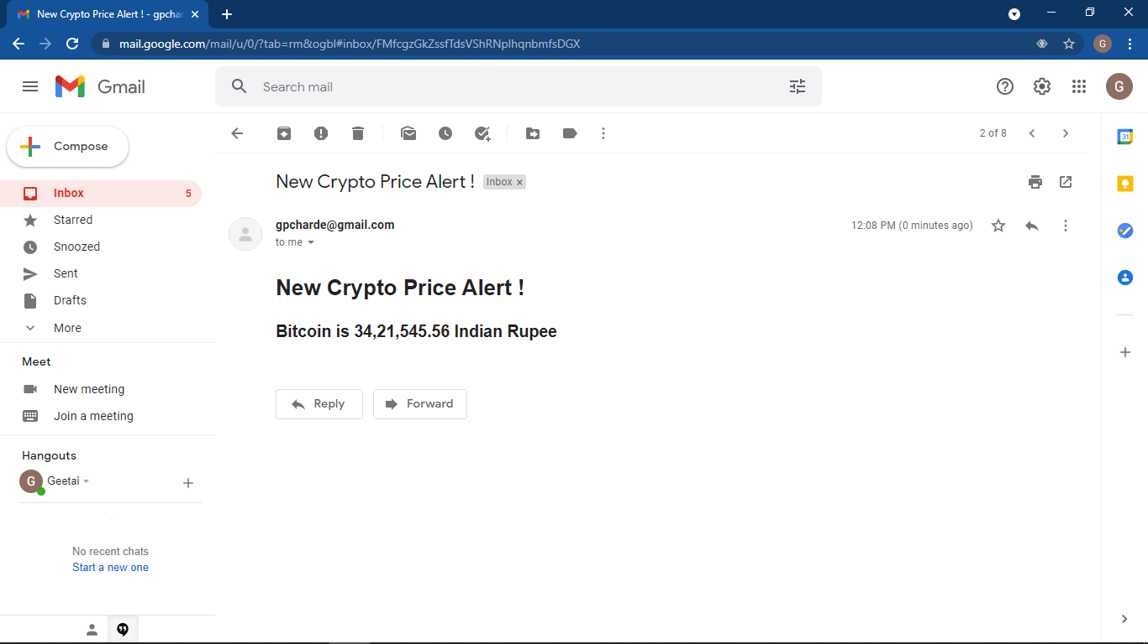
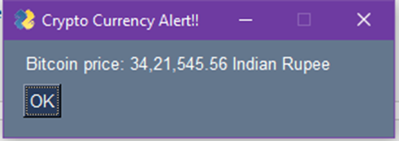
Result
Notification through GUI
Notification on the user’s mail

Slide 8
Advantages:
There is need to check for Bitcoin price manually.
It saves time.
User gets automatically notified.
It will be more beneficial for new users in digital currency business.
Disadvantages:
If the website(from where we get the Bitcoin price) gets change, the system gets fail.

Slide 9
Conclusion
This Bitcoin Notification can be efficiently used for sending an alert to user. The output will be in the form sending an automatic mail to the user or in the form of GUI. Both the outputs are used for notifying the user with the new Bitcoin value.

Slide 10
Reference
https://docs.python.org/3/library/urllib.request.html
https://www.crummy.com/software/BeautifulSoup/bs4/doc/
https://docs.python.org/3/library/ssl.html
https://docs.python.org/3/library/smtplib.html
https://docs.python.org/3/library/time.html

Slide 11
Thank You !!!!

